Slide 1
Expenssy
By-
SHUBHAM ANAND
2200290130157
IT 3rd SEM
SECTION ‘C’

Slide 2
INTRODUCTION
Introducing EXPENSSY, your ultimate expense tracking solution.
Expenssy is a platform at which you can take control of your finances effortlessly and seamlessly it calculates and categorizes your spending. From daily coffee runs to monthly bills, monitor your expenses in real-time, gain insightful reports, and stay on top of your budgeting goals.
Expenssy is simple to use and user-friendly Website.

Slide 3
Purpose Behind Selecting This Project
To helps users, to monitor their spending, track financial habits, set budgets, and analyze expenses.
It provides insights into where money is going, aids in managing finances effectively, and supports better decision-making for budgeting and savings.
Technologies Used
In This Project I have used HTML (Hyper Text Markup Language), CSS(Cascading Style Sheets), JavaScript and ChatGPT.
HTML creates and structures the website's content, CSS adds style and formatting to these structures, and then JavaScript turns those stylized components into something that a user can interact with.
JavaScript can do for the web includes adding interactive behavior to web pages like zooming in and out or playing audio/video. creating web and mobile apps, the most popular examples consist of the likes of Netflix and Uber.
ChatGPT is used to enhance the quality of the overall project.

Slide 4
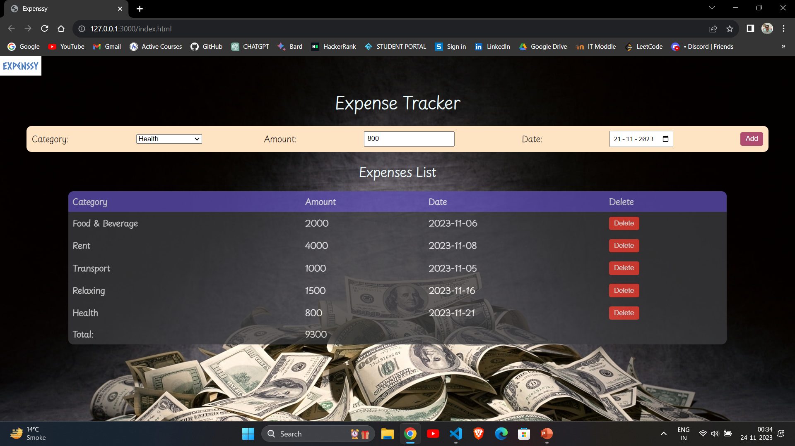
Sample Page

Slide 5
REMAINING WORK
Adding a Save Button -> This Button will be used by user to save all the data in form of pdf format, so that user save the data and track the record.
Making the Site Responsive -> This Site is now not compatible for Mobile Phone, doing this with the help of Bootstrap will make this Site Responsive and help the user to also use it in their mobile phone.
Adding Some Extra Feature -> IN Upcoming days I will add some more Features in this Project so that it becomes more helpful for User.

Slide 6
CONCLUSION
EXPENSSY is a Expense Tracker Website which is used to Track your spending.
Project is Made using Basic HTML, CSS and JavaScript.
Expenssy can be used by Students, Working Professional , Serval Type of Users.
Project is almost 75% ready, and It will be fully functional within few Days although Project is already live and uploaded in my GitHub Account. If anybody wants to use it on their PC, then Just Clink on this link ->> https://shubhamanand2026.github.io/Mini-Project-Sem-III/

Slide 7
Thank You

